Slide 1
Parallel Bellman-Ford algorithm implementation

Slide 2
Outline
Single source shortest path problem and proposed algorithms
Basic parallel implementation of the Bellman-Ford algorithm
Improve work efficiency and data transfer
Performance
Variant for larger graphs

Slide 3
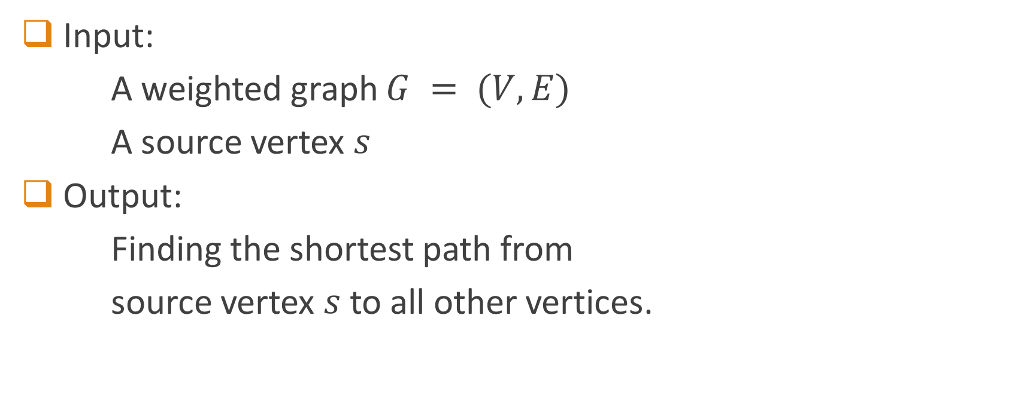
Single Source Shortest Path Problem
Input:
A weighted graph $G = (V, E)$
A source vertex $s$
Output:
Finding the shortest path from
source vertex $s$ to all other vertices.

Slide 4
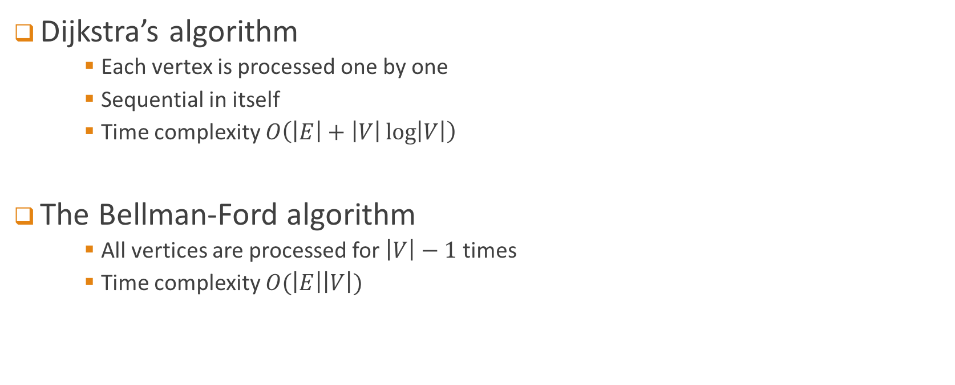
Two algorithms
Dijkstra’s algorithm
Each vertex is processed one by one
Sequential in itself
Time complexity $O\left(\left|E\right|+\left|V\right|\log\left|V\right|\right)$
The Bellman-Ford algorithm
All vertices are processed for $\left|V\right|−1$ times
Time complexity $O(\left|E\right|\left|V\right|)$

Slide 5
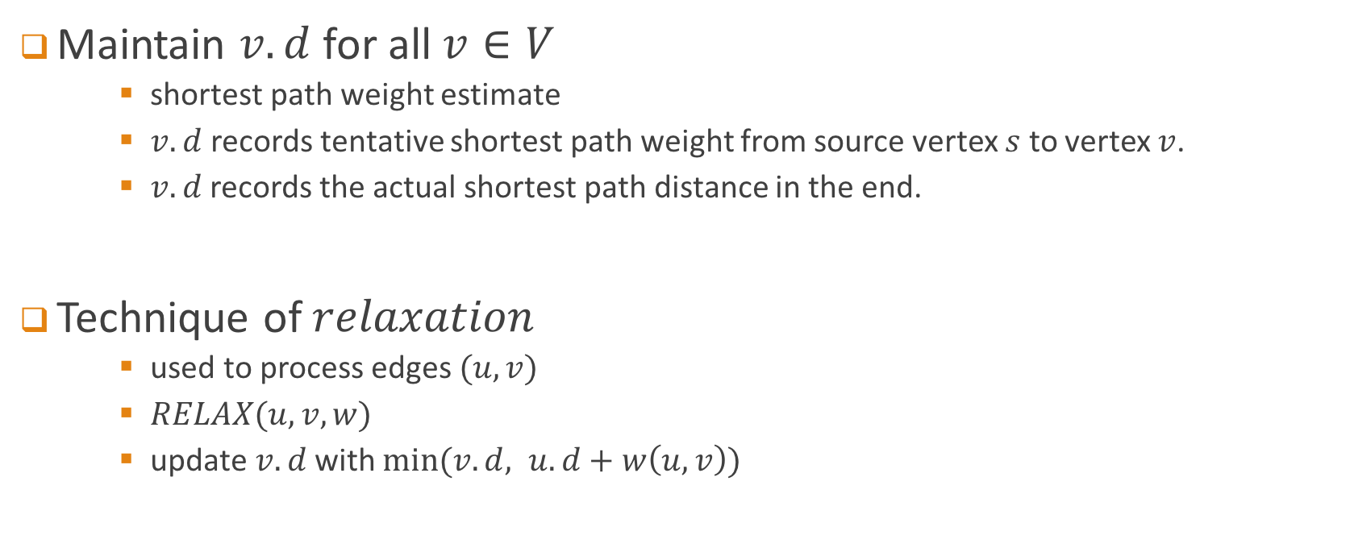
Sequential Bellman-Ford algorithm I
Maintain $v.d$for all $v∈V$
shortest path weight estimate
$v.d$ records tentative shortest path weight from source vertex $s$ to vertex $v$.
$v.d$records the actual shortest path distance in the end.
Technique of $relaxation$
used to process edges $(u, v)$
$RELAX(u, v, w)$
update$v.d$ with $min⁡(v.d, u.d+w\left(u, v\right))$

Slide 6
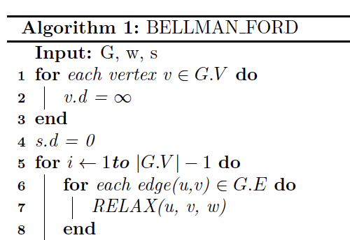
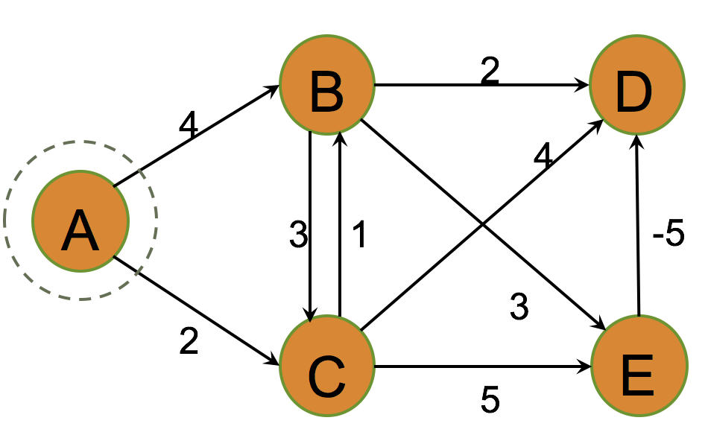
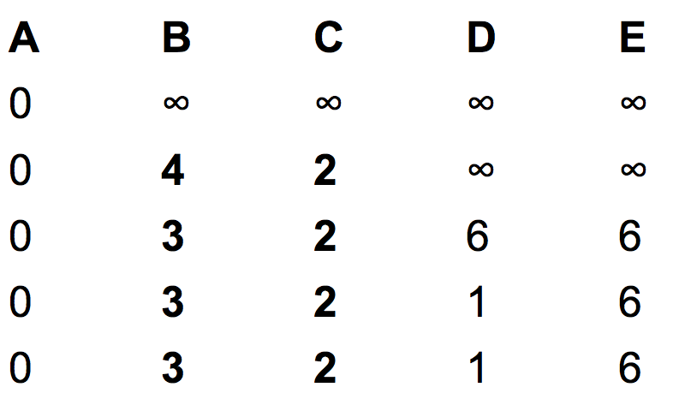
Sequential Bellman-Ford algorithm II

Slide 7
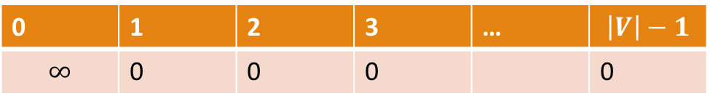
Parallelism
0 | 1 | 2 | 3 | … | $$\left|V\right|−1$$
$$∞$$ | 0 | 0 | 0 |  | 0
Relax all edges in parallel

Slide 8
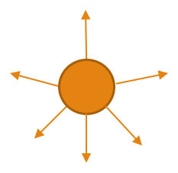
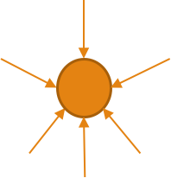
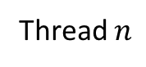
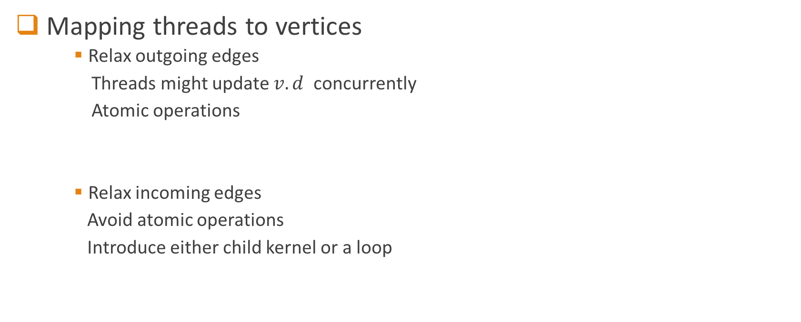
Related work
Mapping threads to vertices
Relax outgoing edges
Threads might update $v.d$ concurrently
Atomic operations
Relax incoming edges
Avoid atomic operations
Introduce either child kernel or a loop
. . . . . . .
Thread 0
Thread 1
Thread $n$
. . . . . . .
. . . . . . .

Slide 9
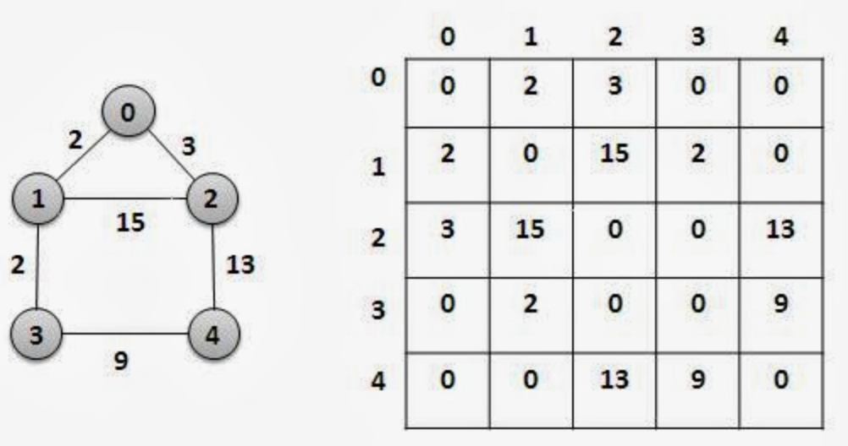
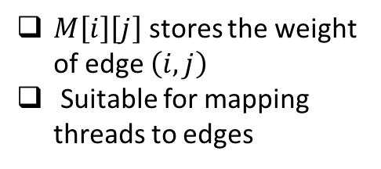
Basic parallel implementation
Graph representation
Adjacency matrix representation
$M\left[i\right]\left[j\right]$ stores the weight of edge $\left(i,j\right)$
Suitable for mapping threads to edges

Slide 10
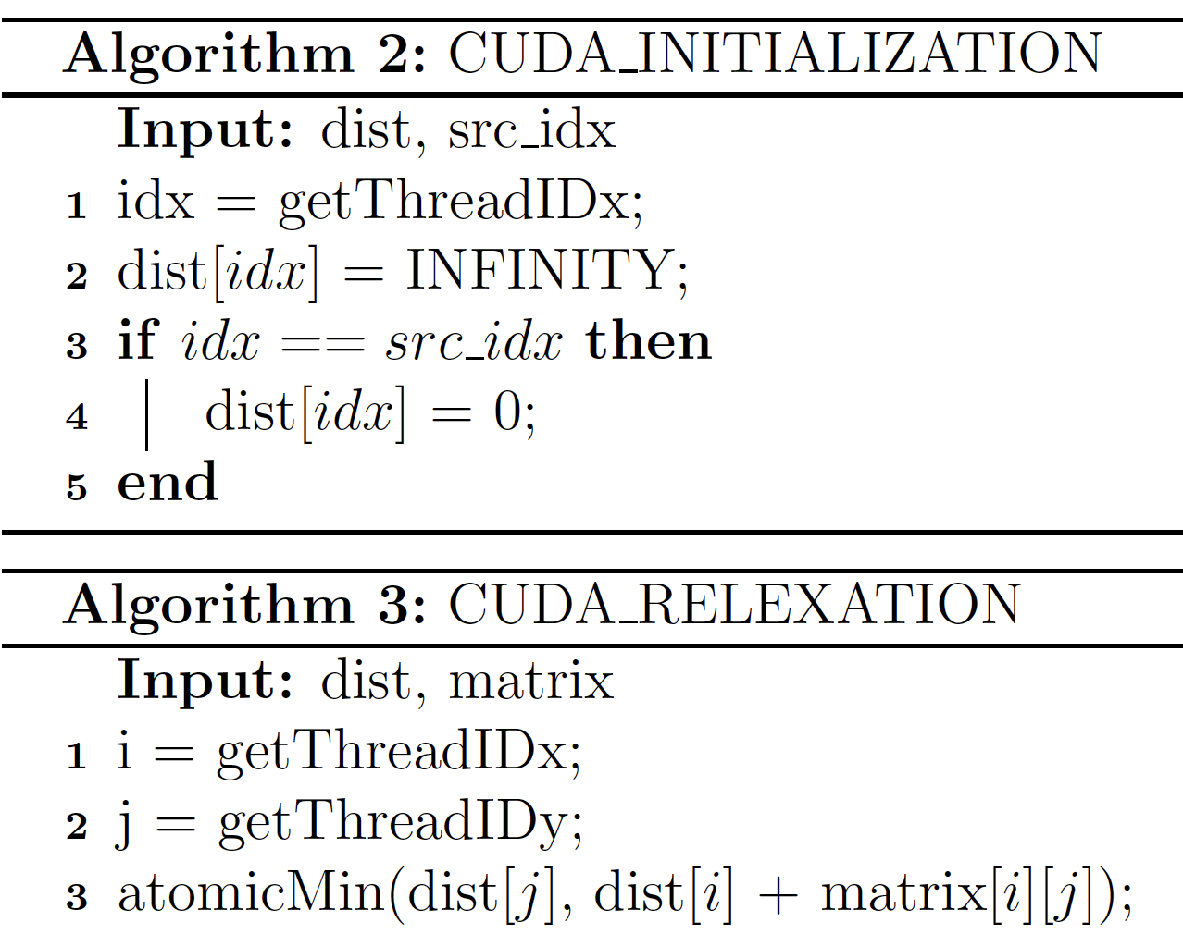
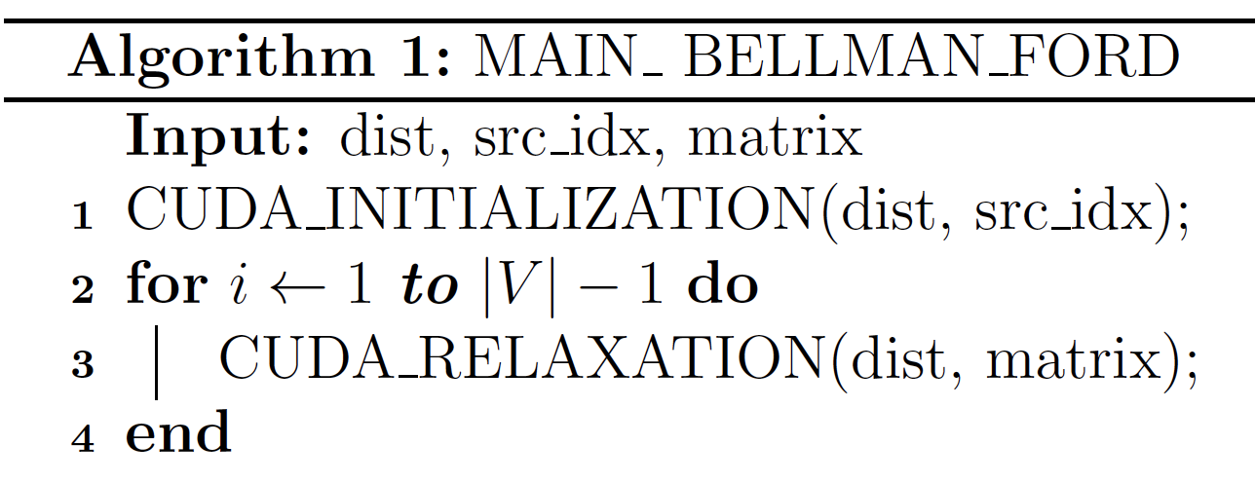

Basic parallel implementation
Pseudocode
$dist$ stores the $v.d$ for all vertices $v$.

Slide 11
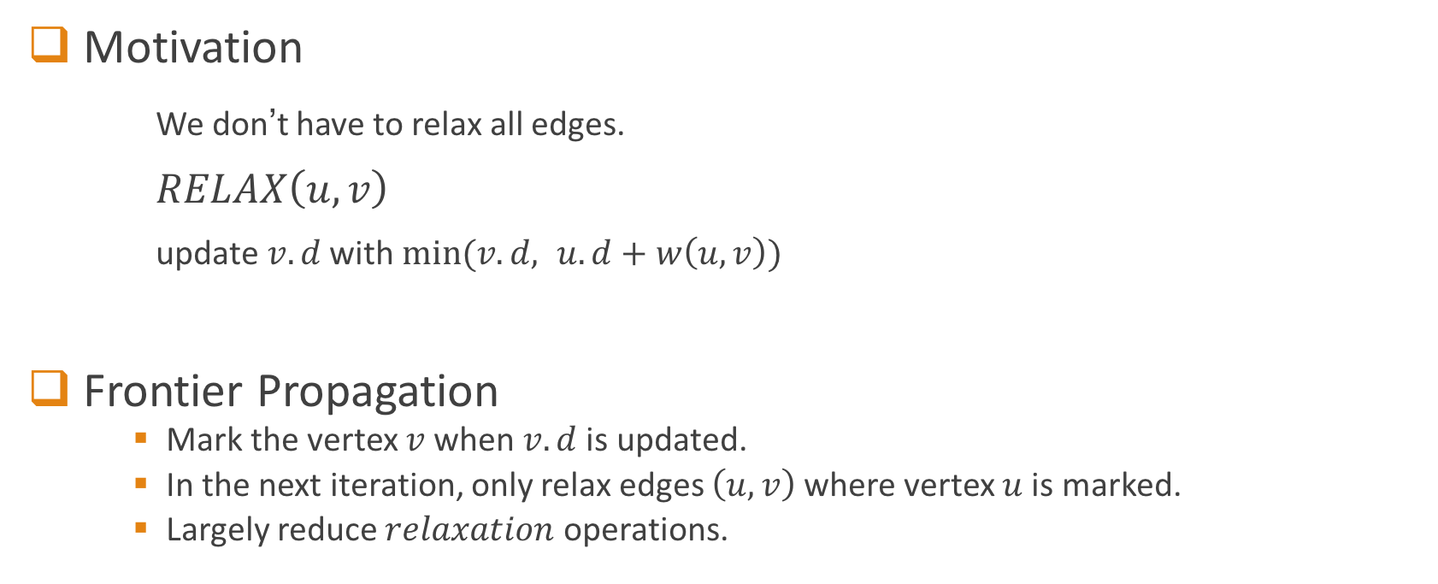
Improve work efficiency I
Motivation
We don’t have to relax all edges.
$RELAX\left(u,v\right)$
update$v.d$ with $min⁡(v.d, u.d+w\left(u, v\right))$
Frontier Propagation
Mark the vertex $v$when $v.d$ is updated.
In the next iteration, only relax edges $\left(u, v\right)$where vertex $u$ is marked.
Largely reduce $relaxation$ operations.

Slide 12
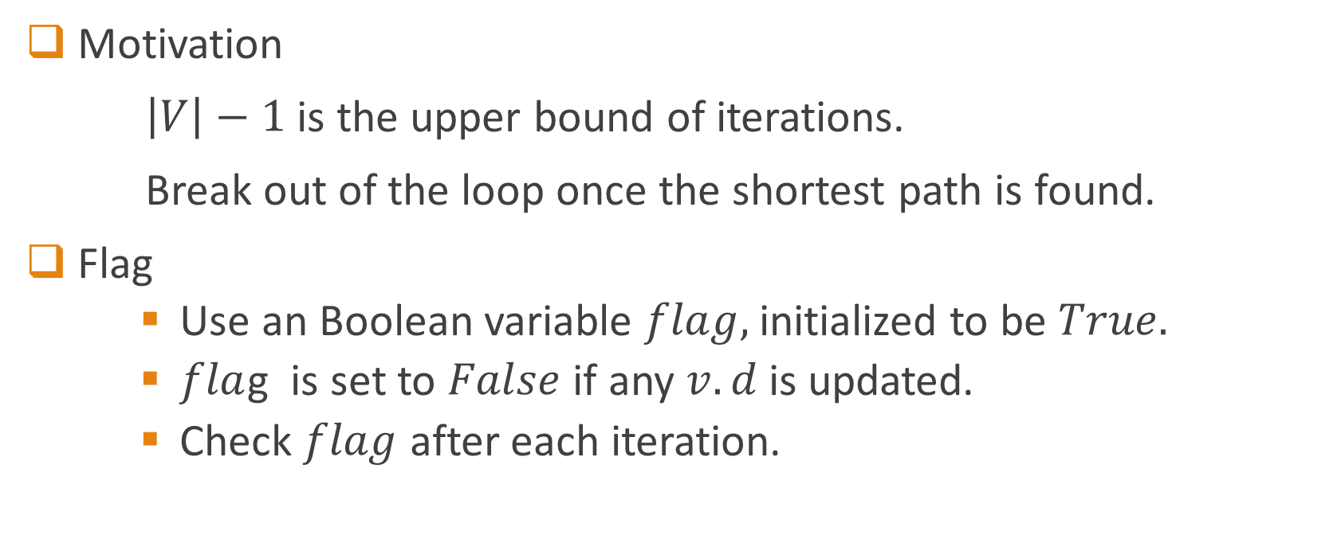
Improve work efficiency II
Motivation
$\left|V\right|−1$ is the upper bound of iterations.
Break out of the loop once the shortest path is found.
Flag
Use an Boolean variable $flag,$initialized to be $True.$
$fla$g is set to $False$ if any $v.d$ is updated.
Check $flag$ after each iteration.

Slide 13
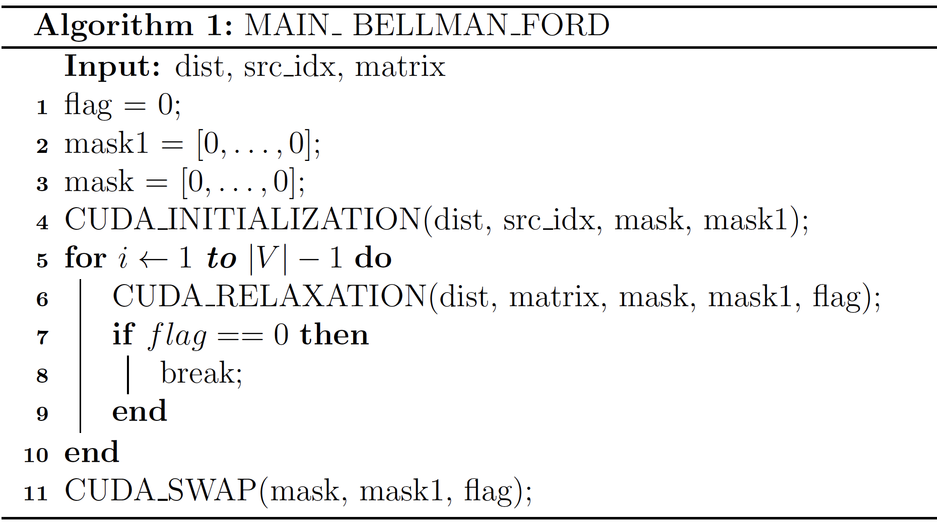
Improved parallel implementation

Slide 14
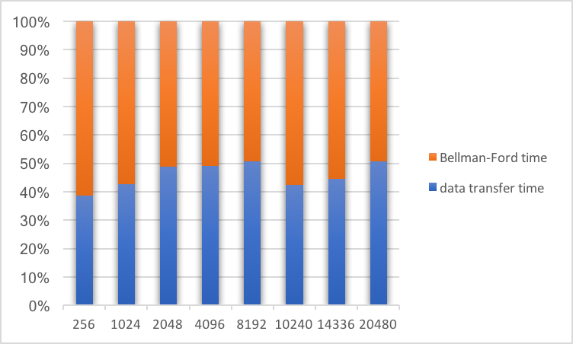
Problem: data transfer
Data transfer and running time

Slide 15
Efficient data transfer I
Pinned memory

Slide 16
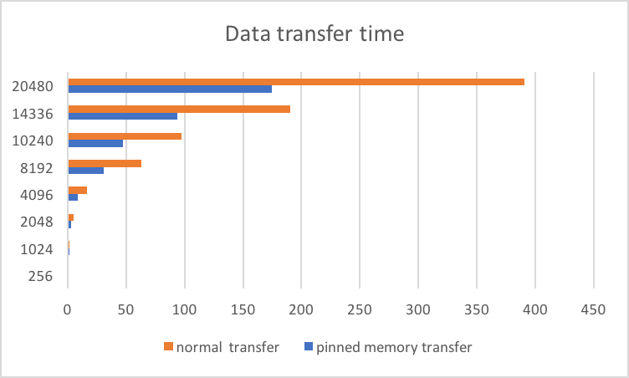
Efficient data transfer I
Pinned memory transfer performance

Slide 17
Efficient data transfer II
Streams
Stream: A sequence of operations that execute in issue-order on the device.
Device operations in different streams may overlap.
Default Stream
Stream 1
Stream 2
Part 1 HtoD
Part 1 HtoD
Part 2 HtoD
Part 1 Kernel
Part 2 HtoD
Part 1 Kernel
Part 1 DtoH
Part 2 Kernel
Part 2 Kernel
Part 2 DtoH
Part 1 DtoH
Part 2 DtoH

Slide 18
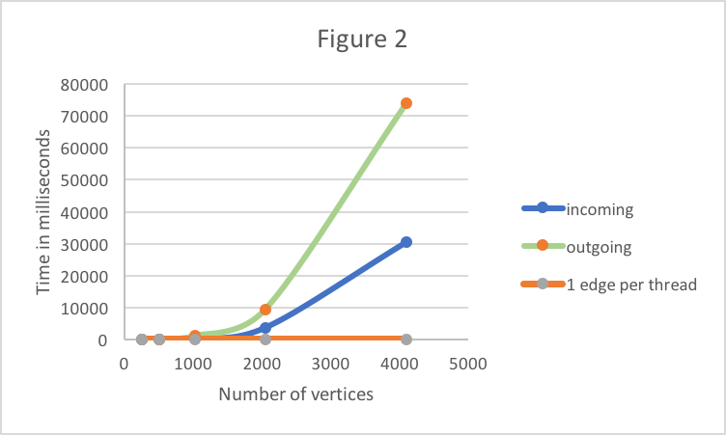
Performance

Slide 19
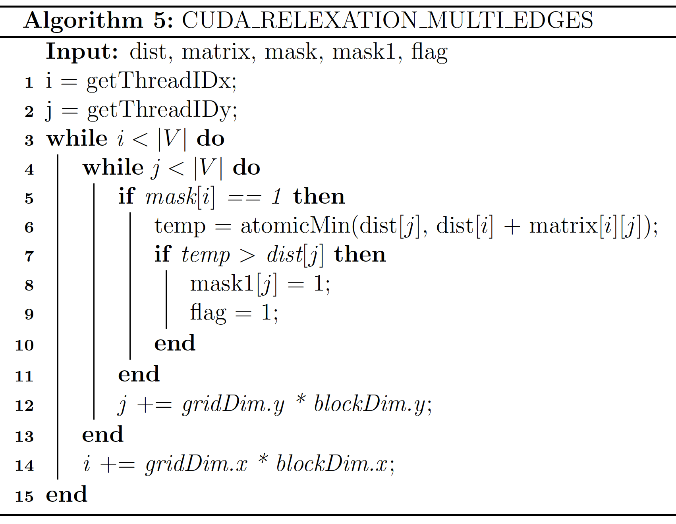
Variant for larger graphs
Limits of hardware
GTX 750 Ti: 5 SMs * 2048 threads per SM = 10240 threads at MAX.
Multiple edges per thread

Slide 20
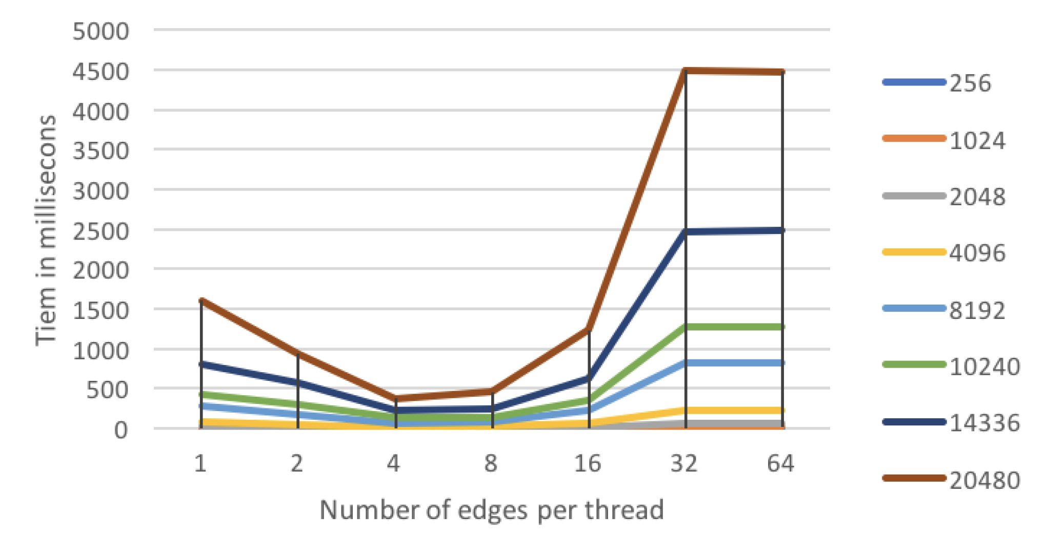
Variant for larger graphs
Number of blocks
Computation power of one thread

Slide 21
Questions

